Slide 1

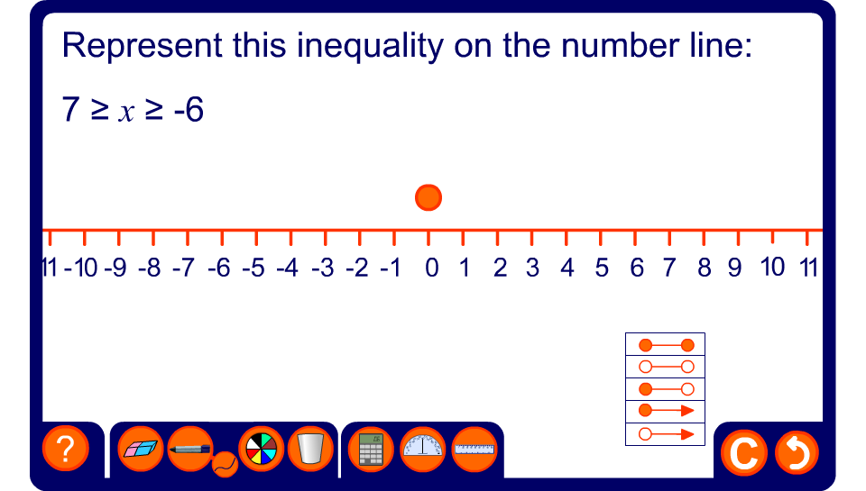


Representing inequalities on the number line

